Slide 1
Matching and Insertions
Eric Prebys, UC Davis

Slide 2
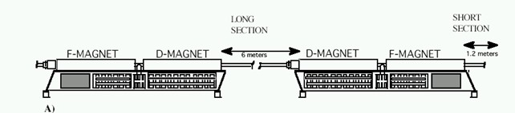
The Problem
So far, we have talked about a synchrotron made out of identical FODO cells, with the space between the quads taken up by bend dipoles.
The problem is that this is not particularly useful, because there’s no place to put beam in or take it out, and no way to collide beams.
One solutions is to design a “straight” into every cell. Example: the Fermilab Booster
However, this is very wasteful of real estate. It would not be practical for the LHC.
x24

Slide 3
Insertions
Since putting a empty straight section in every period is not practical, we need to explicitly accommodate the following in our design:
Locations for injection of extraction.
“Straight” sections for RF, instrumentation, etc
Low beta points for collisions
Since we generally think of these as taking the place of things in our lattice, we call them “insertions”
FODO
FODO
FODO
Insertion
FODO
FODO
FODO
Match lattice functions

Slide 4
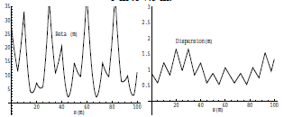
Mismatch and Beta Beating
Simply modifying a section of the lattice without matching will result in a distortion of the lattice functions around the ring (sometimes called “beta” beating)
Here’s an example of increasing the drift space in one FODO cell from 5 to 7.5 m

Slide 5
Collins Insertion
A Collins Insertion is a way of using two quads to put a straight section into a FODO lattice
Where s₂ is the usable straight region

Slide 6
Require that the lattice functions at both ends of the insertion match the regular lattice functions at those point
Where μ_{I} is a free parameter
After a bit of algebra
Maximize s₂ with μ_{I}=π/2, α max (which is why we locate it L/2 from quad)
Works in both planes if α_{x}=-α_{y} (true for simple FODO)

Slide 7
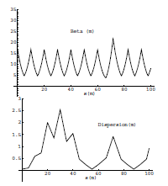
Dispersion Mismatch
The problem with the Collins insertion is that it does not match dispersion, so just sticking it in the lattice will lead to distortions in the dispersion
Collins Insertion

Slide 8
Dispersion
There is no way to bend a beam in a curved path without introducing dispersion.
There are three cases dispersion is desirable:
To be used in combination with sextupoles to introduce chromaticity adjustment
To be used in combination with a collimation system to eliminate particles which are too far away from the nominal momentum.
Used in conjunction with various types of “cooling” to reduce energy spread.
In all other cases, dispersion is a problem
Makes the beam bigger than it needs to be
Introduces problematic energy/position correlation

Slide 9
Dispersion Suppression
Recall that dispersion propagates as
For a straight section, d(s)=d’(s)=0, but dispersion will still propagate unless D(0)=D’(0)=0 is also true.
➔”Dispersion Suppression”

Slide 10
Dispersion Suppression (cont’d)
On common technique is called the “missing magnet” scheme, in which the FODO cells on either side of the straight section are operated with two different bending dipoles and a half-strength quad
Recall that the dispersion matrix for a FODO half cell is (lecture 4)
Straight section
Mirror image

Slide 11
So we solve for
Where D_{m} and D’_{m} are the dispersion functions at the end of a normal cell (for a simple lattice, D’_{m}=0)
We get the surprisingly simple result

Slide 12
“Missing Magnet” Cofiguration
If we look at our solution
And consider the case θ=60°, we get
So the cell next to the insertion is normal, and the next one has no magnets, hence the name “missing magnet”.

Slide 13
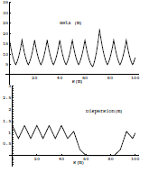
Combining Insertions
Because the Collins Insertion has no bend magnets, it cannot generate dispersion if there is none there to begin with, so if we put a Collins Insertion inside of a dispersion suppressor, we match both dispersion and the lattice functions.

Slide 14
Low β Insertions
In a collider, we will want to focus the beam in both planes as small as possible.
This can be done with a symmetric pair of focusing triplets, matched to the lattice functions (dispersion suppression is assumed)
Recall that in a drift, β evolves as
Where s is measured from the location of the waist
Symmetric
FODO
FODO
FODO
FODO
triplet
triplet
FODO
FODO
FODO
FODO
Dispersion suppression
Dispersion suppression

Slide 15
Phase Advance of a Low Beta Insertion
We can calculate the phase advance of the insertion as
For L>>β*, this is about π, so
Matching guaranteed if insertion is symmetric!

Slide 16
Optics Near Low-β Insertion
β
➔ small β* means large β (aperture) at focusing triplet
s

Slide 17
Putting the Pieces Together
So now we see that in general, a synchrotron will contain
A series of identical FODO cells in most of the ring.
Straight sections, with modified cells on either end.
Dispersion suppression before and after these straight sections
If it’s a collider, it will also contain
One or more low beta insertions with dispersion suppression on either side.
The beta function will be very large on either side of the low beta point

Slide 18
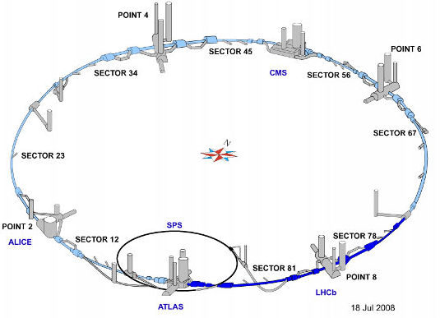
Example: LHC
Recall the LHC layout
Superperiodicity of 8
Need insertions for two low beta collision regions (ATLAS, CMS)
Two higher beta collision regions (ALICE, LHCb), which double as injections points.
Other straights for RF cavities, beam extraction, etc.

Slide 19
LHC Optics (out of date)
Low β collisions
Injection straights/higher β collisions
Dispersion Suppression

Slide 20
Beam Line Issues
Beam lines are typically built in discrete sections:
Matching (to a source, injection point, or extraction point)
Transport:
The FODO cells we’ve been talking about
Bends
Designed as “achromats” to suppress dispersion!
Focus (or “waist”)
Uses quad triplet to minimize beta in both planes
Collimation sections
90°apart in phase space to clean up 2D phase space

Slide 21
Final Focus Triplet
As we saw, our normal FODO cell has maxima in one plane where the minima are in the other.
For targets or collisions, we want small beta functions in both planes.
This optical problem can be solved with a triplet
Middle quad ~twice the strength of outer quads (HW problem for next week)

Slide 22
Dispersion Suppression
Any bend section will introduce dispersion. After the bend, it will propagate as
It will never go away unless we explicitly suppress it in the design

Slide 23
Dispersion due to a Dipole
We already solved for the dispersion introduced by a bend dipole
So if the beam line has no dispersion going into the dipole, it will exit with dispersion

Slide 24
Propagation of Dispersion
In the absence of additional bends, the beam the dispersion will propagate just like any other orbit.
We’ll consider the special case of
If, in addition, we make the line symmetric, so the lattice functions are the same at the end as the beginning, this simply reduces to

Slide 25
Canceling Dispersion
If we put a second magnet at the end of this line, it will modify the dispersion as
So we can cancel the dispersion by setting and the dispersion will remain zero until the next bend magnet
Such a section of beam line is referred to as an “achromat”

Slide 26
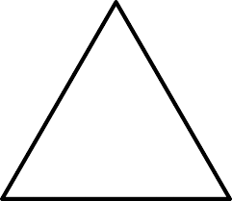
Achromats
If the line has 360° of phase advance, we can cancel dispersion with an opposite sign dipole➔”dogleg achromat”
If the line has 180°of phase advance, we can cancel dispersion with a same sign dipole ➔”double-bend achromat”
Can be incorporated into rings

Slide 27
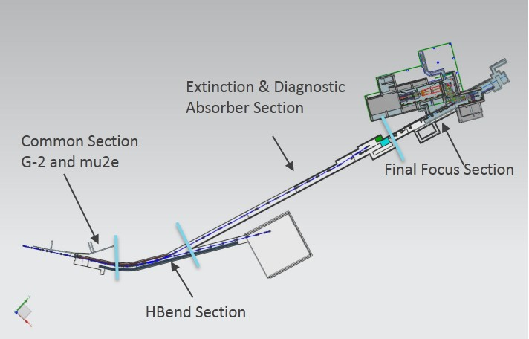
Example: Mu2e Proton Beam
Muon production target
triplet
collimator
weird magnet requirement
”achromat”
matching

